Slide 1
Preparation of Cash Budget and Flexible Budget

Slide 2
1.) Preparing ‘Budgets’
Prepared in ‘Advance’
Preparing
‘Budget’
A Financial Plan showing:
1.) Sales Revenue (to be earned)
2.) Cost (to be incurred)
Prepared for ‘future period’

Slide 3
2.) Doing ‘Budgeting’
‘Budgeting’ → Preparing different types of budgets
Master Budget (Combine all budgets into one overall budget)
Cash Budget (Estimating future cash receipts & payments)
Sales Budget (Forecast Sales)
Production Budget (Finding cost to be spent on making ‘food items’ & to provide ‘rooms’
Labor Budget (Estimating labor required for production)

Slide 4
3.) Budgetary Control
Prepare ‘Budgets’
Find ‘Actual Performance’
Comparing actual performance with set standards.
Finding Reasons for ‘Variance’
Take ‘Corrective Actions’

Slide 5

Poll
ITC has prepared a flexible budget to manufacture 500 units of Surf Excel.
The per unit cost of it’s semi – variable expenses is Rs. 10 (20% is fixed).
In such case, the total fixed costs (in Rs.) will be:
6000
4000
1000
16000

Slide 6
Preparation of ‘Flexible Budget’ of HUL
Particulars | 50% Capacity | 60% Capacity | 70% Capacity
Variable Overheads: Material Labor |  | 6,000 18,000
Fixed Overheads: Insurance Depreciation |  | 15,000 20,000
Semi – Variable Overheads: Electricity (40% fixed) Repairs (20% Variable) |  | 30,000 3000

Slide 7
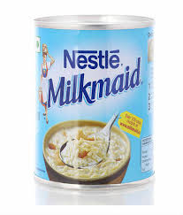
Poll
Nestle India has prepared a flexible budget to manufacture 1000 units of Milkmaids.
The total semi – variable expenses are Rs. 40,000 (70% fixed, 30% variable).
In such case, the per unit fixed costs (in Rs.) will be:
28
40
12
16

Slide 8
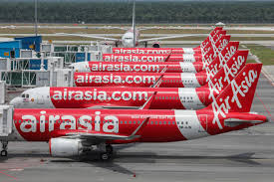
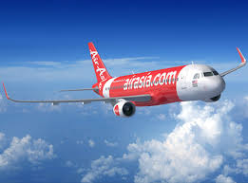
Budgets at Air Asia
‘Air Asia’ prepared estimates of Sales of it’s air tickets from (1st April 2020 – 31st March 2021).
These estimates are based upon the ever changing business conditions.
Worst Scenario (suspension of flights with on struck of new strains of Covid virus; no sales)
Normal Scenario (when sales are normal, flights are operational)
Best Scenario (when sales are high, during festive seasons such as Xmas, New year etc)

Slide 9
What Air Asia is actually doing?
Preparing Flexible Budget
Prepared for different levels of activities
Adjusted according to changing busines conditions
Dynamic in nature
Divides cost into fixed, variable, semi variable costs

Slide 10
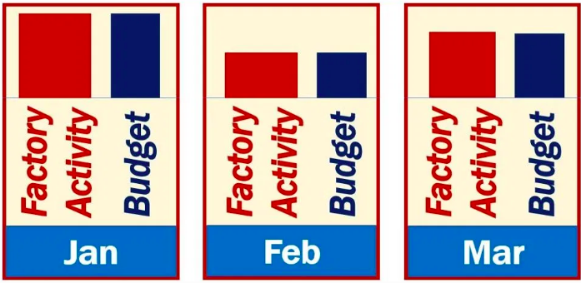
Flexible Budget {Varies according to changing needs of business}

Slide 11
A.) Cash Receipts
An outlet of ‘Burger King’ prepares the estimate of the following cash transactions for the months of May – Sept 2021
Old machinery sold in month of August $200
The money is collected from debtors with lag of 1/2 month.
The Opening Cash Balance on June 1st 2020 was 1000$.
Find the total cash receipts for the month of June, July and August 2021
Particulars | May | June | July | August | September
Credit Sales | 600 | 700 | 800 | 900 | 1000
Cash Sales | 400 | 600 | 1000 | 1200 | 1600

Slide 12
CASH BUDGET
Particulars | June | July | August

Slide 13
Working Notes
Month | Credit Sales | Actual Amount received ( in Rs.)
May | 600
June | 700
July | 800
August | 900
September | 1000

Slide 14

Poll – II
An outlet of ‘Raymond Inc.’ provides the sales information (in $) from Jan – Apr 2021.
Half of Sales amount is collected in same month and remaining half in immediate next month.
In such case, the ‘cash collected’ in the month of March 2021, to be recorded in ‘cash budget’ will be:
$5000
$6000
$4000
$8000
Jan | Feb | March | April
2000 | 6000 | 4000 | 8000

Slide 15
B.) Cash Payments (or disbursements)
An outlet of ‘Burger King’ prepares the estimate of the following cash transactions for the months of May – Sept 2021
It made payment for repairs of its building $100 in month of July
Lag in payment of expenses is by 1/8th month.
Find the total cash payments for the month of June, July and August 2021
Particulars | May | June | July | August | September
Payment of expenses | 600 | 700 | 800 | 900 | 1000

Slide 16
CASH BUDGET
Particulars | June | July | August

Slide 17
Working Notes
Month | Payment of Expenses | Actual Amount paid ( in Rs.)
May | 600
June | 700
July | 800
August | 900
September | 1000

Slide 18
Poll
An outlet of ‘Raymond Inc.’ provides the information (in $) from Jan – Apr 2021 related to its’ payment of wages.
Lag in payment of wages is by 1/4th month.
In such case, the ‘wages paid’ in the month of Feb 2021, to be recorded in ‘cash budget’ will be:
$1500
$250
$750
$1750
Jan | Feb | March | April
1000 | 2000 | 4000 | 6000
Notes:
d

